Slide 1
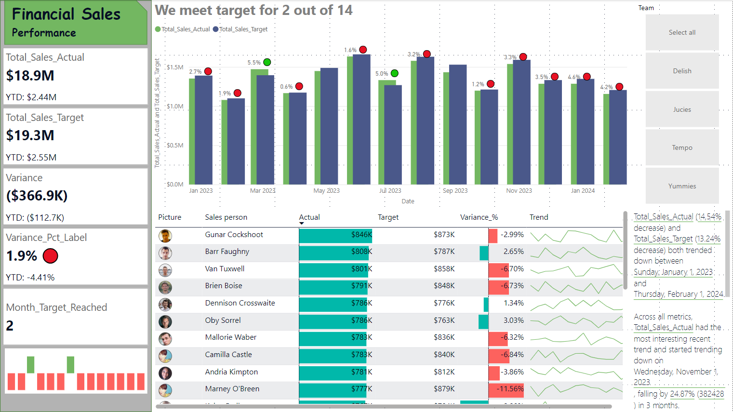

Slide 2
Financial sales

Slide 3
Main Objective
The primary goal this dashboard is get insight performance Team and Sales Person from Jan 2023 – Feb 2024
There are 4 team in this dataset

Slide 4
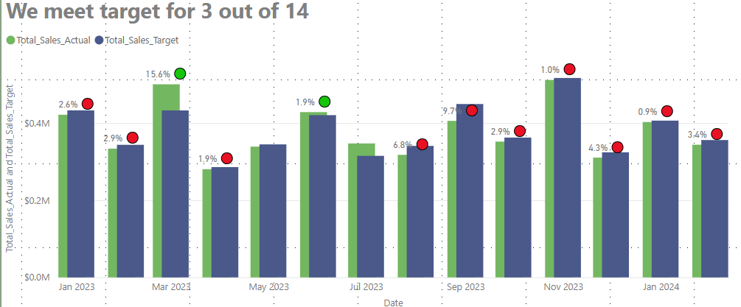
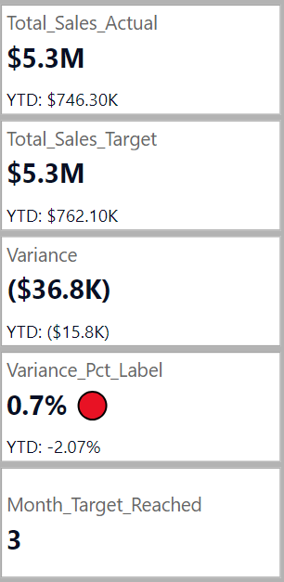
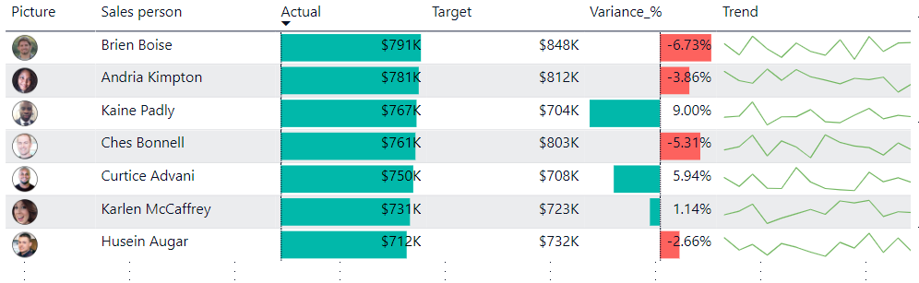
Team 01
Total Sales Actual (18.44% decrease) and Total Sales Target (17.77% decrease) both trended down between Sunday, January 1, 2023 and Thursday, February 1, 2024.﻿﻿ ﻿﻿
﻿Target Status experienced the longest period of decline (-2) between Thursday, June 1, 2023 and Tuesday, August 1, 2023.﻿﻿ ﻿﻿ ﻿

Slide 5
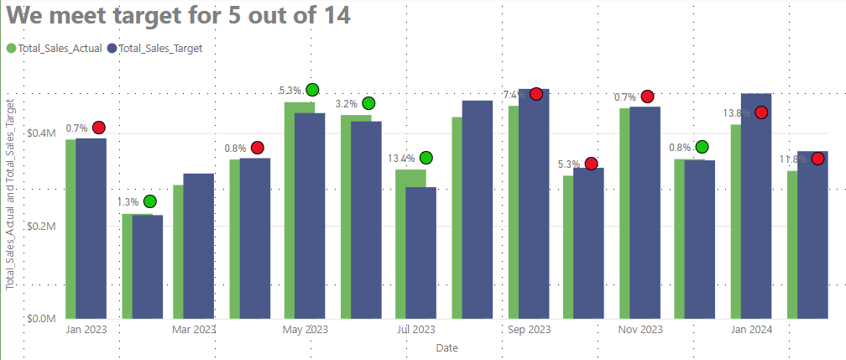
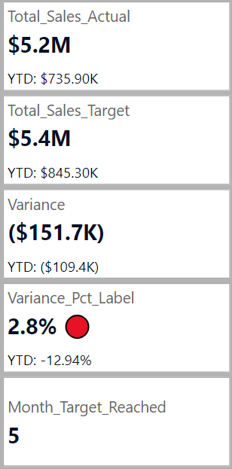
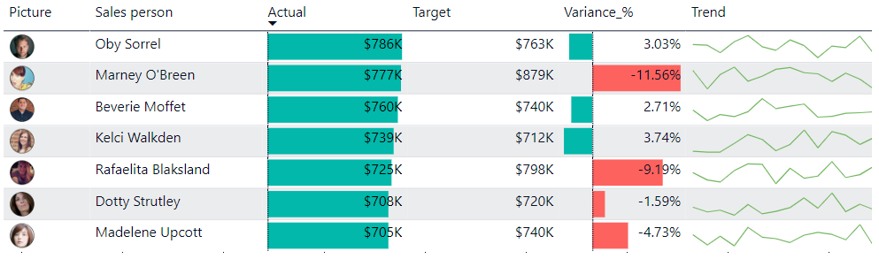
Team 02
﻿﻿Total Sales Actual (17.51% decrease) and Total Sales Target (7.14% decrease) both trended down between Sunday, January 1, 2023 and Thursday, February 1, 2024.﻿﻿
﻿﻿﻿﻿Total Sales Actual started trending down on Wednesday, November 1, 2023, falling by 29.76% (134,777.25) in 3 months.﻿﻿

Slide 6
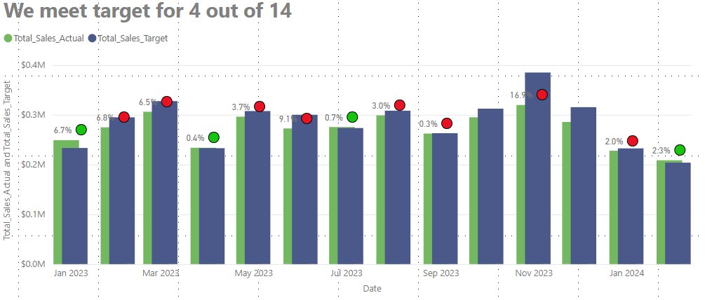
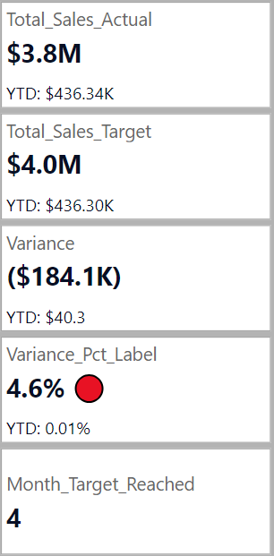
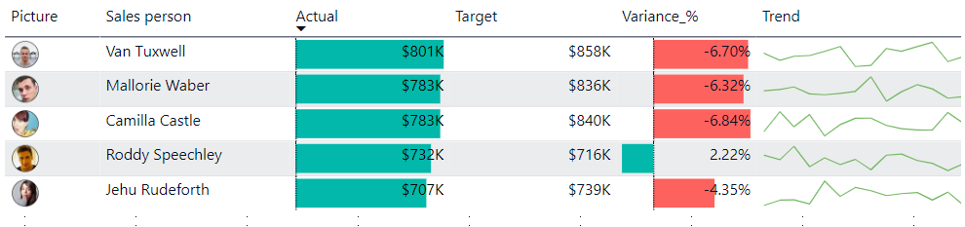
Team 03
﻿Total Sales Actual (16.24% decrease) and Total Sales Target (12.64% decrease) both trended down between Sunday, January 1, 2023 and Thursday, February 1, 2024.﻿﻿ ﻿﻿ ﻿﻿Across all metrics, Total Sales Actual had the most interesting recent trend and started trending down on Wednesday, November 1, 2023, falling by 34.77% (111,190.50) in 3 months.﻿﻿ ﻿﻿
Total Sales Actual dropped from 319,745.25 to 208,554.75 during its steepest decline between Wednesday, November 1, 2023 and Thursday, February 1, 2024.﻿﻿ ﻿﻿
﻿﻿Target Status experienced the longest period of decline (-2) between Sunday, January 1, 2023 and Thursday, June 1, 2023.﻿﻿ ﻿﻿ ﻿

Slide 7
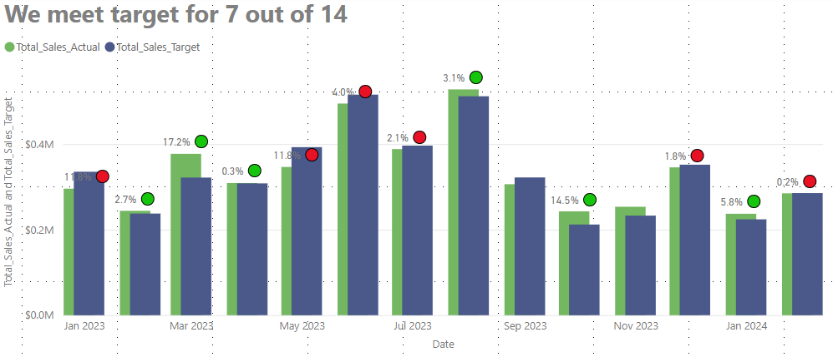
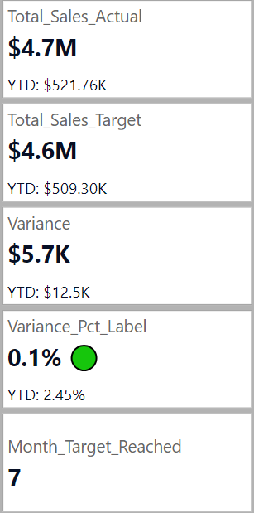
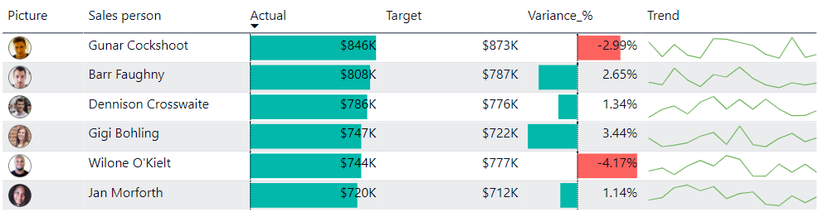
Team 04
﻿ ﻿Total Sales Target (14.89% decrease) and Total Sales Actual (3.69% decrease) both trended down between Sunday, January 1, 2023 and Thursday, February 1, 2024.﻿﻿ ﻿﻿ ﻿﻿Total Sales Target started trending down on Wednesday, November 1, 2023, falling by 3.74% (8700) in 2 months.﻿﻿ ﻿﻿ ﻿
Total Sales Actual jumped from 295668 to 377,041.50 during its steepest incline between Sunday, January 1, 2023 and Wednesday, March 1, 2023.﻿﻿
﻿﻿Target Status experienced the longest period of decline (-2) between Wednesday, February 1, 2023 and Saturday, July 1, 2023.﻿﻿ ﻿﻿ ﻿

